Slide 1
Covalent Network Substances

Slide 2
Covalent Network Substances

Slide 3
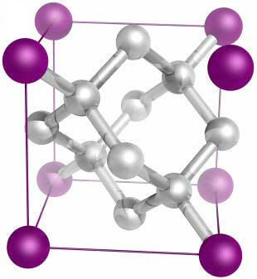
Substances that exist as large interconnected networks of atoms are known as covalent network substances.
Before we can move onto defining covalent network substances, we have to look at the type of bonding that allows them to form: covalent bonding.
Understanding the properties and relative strength of covalent bonds will better allow us to describe and explain the properties and bonding within covalent network substances.

Slide 4
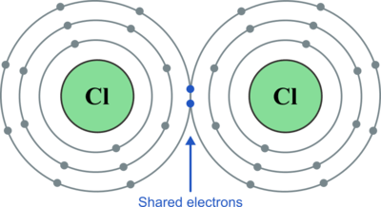
A covalent bond is a type of bond which occurs between two non-metal atoms.
In order for both atoms to fill their outer (valence) shell and become stable, each atom must share one electron with the other.
Covalent bonding occurs between all non-metal atoms (except for the noble gases), for example, in oxygen gas (O₂​), nitrogen gas (N₂​) and multiple carbon based compounds, such as ethane (C₂​H₆​).
Covalent bonding forms incredibly stable molecules. These molecules make up a large proportion of the compounds found in nature and the building blocks of biological material.
Depiction of a covalent bond between two chlorine atoms. Each chlorine atom shares one valence electron to gain a full outer shell of eight electrons.

Slide 5
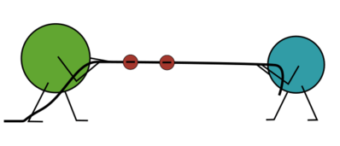
What makes covalent bonds so strong?
A covalent bond relies upon the electrostatic attraction between the shared electrons and the nuclei of the two atoms that shared those electrons.
Neither atom wants to lose its full valence shell, as this would result in lower stability, so it requires high amounts of energy to break these electrostatic attractions.

Slide 6
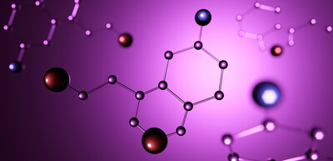
Covalent bonds between atoms are not just limited to single electron exchanges between two atoms.
This means double (two electrons shared) or triple (three electrons shared) bonds can form between two individual atoms.
Atoms can also form covalent bonds with a number of different atoms at the same time, allowing complex molecules to form. These molecules can have complex crystalline structures that result in unique physical properties developing.

Slide 7
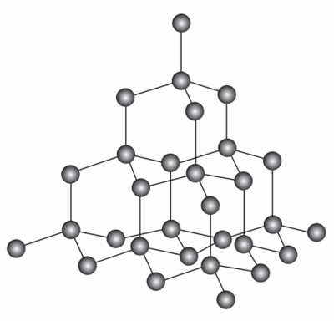
Substances in which the atoms are covalently bonded to one another in a large multi-dimensional network are known as “covalent network substances” or “macromolecules”.
These substances do not exist as discrete molecules but rather as an extended network of covalently bonded atoms. These networks can be either two or three dimensional in nature.
An excellent example of a covalent network substance is diamond, which consists of a 3-D network of carbon atoms, each one covalently bonded to the surrounding 44 carbon atoms.

Slide 8
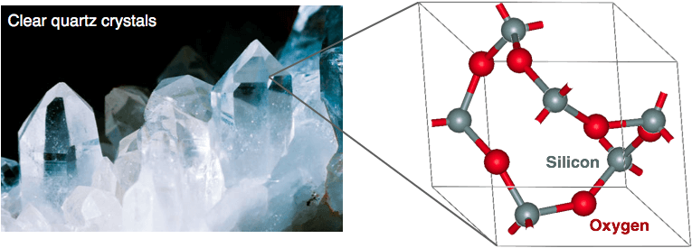
Covalent network substances exist as a continuous network of covalently bonded atoms.
More complex substances that consist of multiple elements need to be defined by their empirical formula.
An empirical formula is a chemical formula giving the proportional amount of the elements present in a compound, but not the actual numbers or arrangement of atoms.

Slide 9
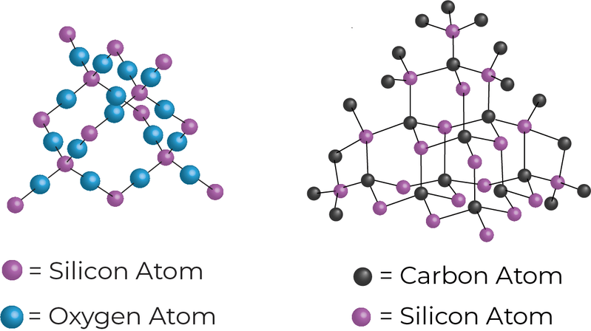
Empirical Formula Examples
Silicon dioxide, also known as silica, is a covalent network substance made up of silicon and oxygen. Each silicon atom is covalently bonded to 44 oxygen atoms and each oxygen is bound to 22 silica atoms within the 3-D lattice. The resulting molecule has an empirical formula of SiO₂​.
Silicon carbide is another example of covalent network substance, comprised of silicon and carbon. Each silicon atom is bound to 44 carbon atoms and each carbon is bound to 44 silica atoms within the 3-D lattice, giving the empirical formula SiC.

Slide 10
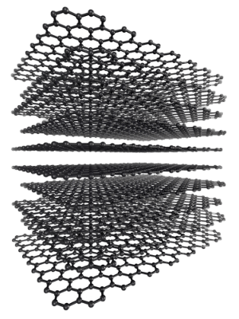
One of the ways covalent network substances can be arranged is into a 2-dimensional network.
The addition of this multi-dimensional structure to the bonding gives rise to some unique physical properties.

Slide 11
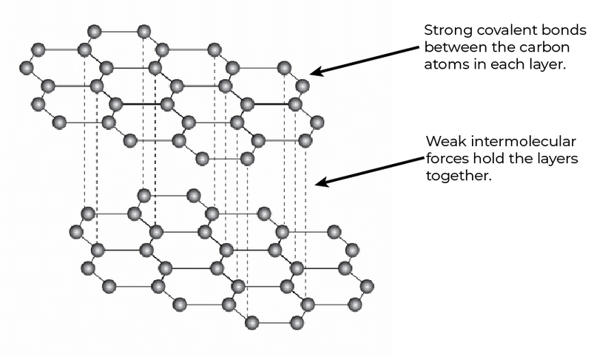
In 2-D network substances, the atoms are covalently bonded in a flat, sheet-like arrangement.
These are then held together by intermolecular forces occurring between the sheets.
These intermolecular forces are significantly weaker than the covalent bonds that exist between the atoms of each of the layers.

Slide 12
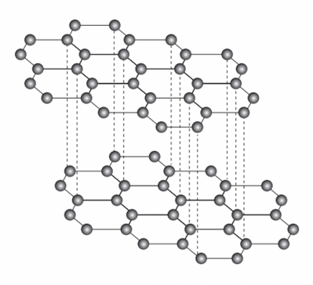
An example of a 2-D network substance is graphite.
Here each sheet consists of a carbon atom covalently bonded to 33 other carbon atoms to produce a flat hexagonal based sheet that is one atom thick.
This bonding arrangement leaves each carbon atom with a spare unbound valence electron, which is free to move throughout the substance. This is known as a delocalised electron, and the presence of these delocalised electrons in graphite allows it to conduct electricity.

Slide 13
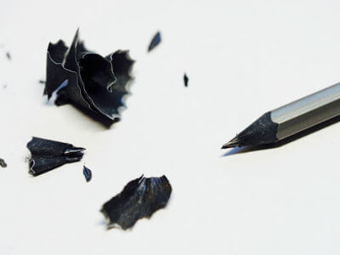
Graphite consists of multiple hexagonal sheets of carbon that are one atom thick.
These sheets are held together by weak intermolecular forces, allowing the sheets to move over one another without disrupting the covalent bonds within each sheet. This causes graphite to be a rather soft, brittle, slippery solid, which allows for its use in pencil lead. As the pencil is rubbed onto the paper, the individual layers are deposited onto the page.

Slide 14

Some of the hardest materials found in the natural world are comprised of 3-D covalent network substances.
These can range from diamond tipped industrial tools to silicon carbide based grinders and abrasives (such as sandpaper). The arrangement and number of covalent bonds within these structures are what give them their physical properties.

Slide 15
In a 3-D covalent network substance, every atom is covalently bonded to the atoms situated around it, forming a strong rigid lattice.
This large number of covalent bonds gives 3-D covalent solids their unique physical properties.
3-D covalent network substances are considered incredibly hard/rigid and have high melting points, due to the large number of strong covalent bonds present.

Slide 16

Let's look at silicon dioxide as an example.
Silicon dioxide is one of the most common compounds on the planet. It is the primary constituent of the mineral quartz and makes up the majority of the chemical makeup of sand.
The bonding within the crystal structure consists of a 3-D network of silicon atoms covalently bonded to 4 oxygen atoms in a tetrahedral configuration. Each oxygen atom is then bound to 2 silicon atoms within the extended structure, giving it an empirical formula of SiO₂​. This formula is used to denote silicon dioxide even though it does not exist in nature as a discrete SiO₂​ molecule.
Silicon dioxide has a number of uses, ranging from its use as the main ingredient in concrete for construction, to being the primary constituent in glass production.

Slide 17

Silicon carbide is another example of a 3-D covalent network substance.
The bonding within the crystal structure consists of a 3-D network of silicon atoms covalently bonded to 4 carbon atoms in a tetrahedral configuration. Each carbon atom is then bound to 4 silicon atoms within the extended structure.
Silicon carbide is extremely hard and is often used as an abrasive in grinding discs, as sandpaper or as grip tape on skateboards.

Slide 18
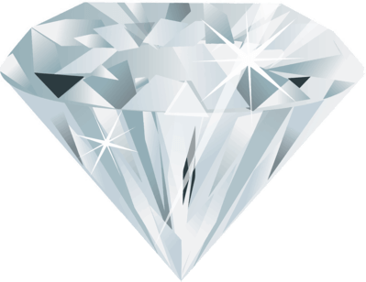
3-D covalent network substances are considered some of the hardest naturally occurring compounds on the planet. An example of this is diamond, which is so hard it is used to create industrial cutting tools.
This is due to the incredibly rigid and stable lattice structure inherent in a 3-D network. The multiple bonds allow the molecule to resist a large amount of force applied from any direction. However, they are also highly inflexible, and are likely to shatter rather than bend when excessive force is applied to them.

Slide 19
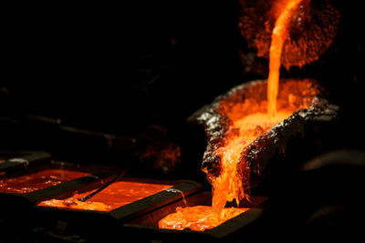
The high melting points of 3-D covalent network substances are again related to the network of covalent bonds within the structure.
Covalent bonds create a strong electrostatic attraction between the nuclei and the shared electrons which requires a large amount of energy input to break.
Since the 3-D network substances have many covalent bonds, it takes incredibly large amounts of energy to melt a 3-D network solid. This is seen in diamond, which has a melting point of 3500∘C, and is only achievable under immense pressure.

Slide 20
Physical Properties of Covalent Network Substances

Slide 21
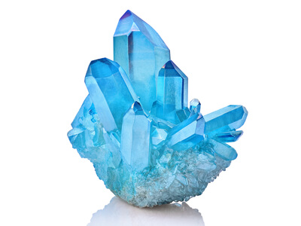
The structure and bonding within a covalent network substance affect the physical properties it displays.
The physical properties we will be covering are:
Melting point
Electrical conductivity
Thermal conductivity
Hardness and brittleness
Solubility

Slide 22
There are two types of covalent network substances: 2-D and 3-D.
The bonding between atoms and their arrangement within covalent network substances are what give these substances their unique physical properties.
For this section we will be covering 2-D covalent network substances, with graphite being a common example.
Graphite consists of carbon atoms covalently bonded to three other carbon atoms, forming hexagonal based sheets, one atom thick. These sheets are then bound together through weak intermolecular forces.

Slide 23
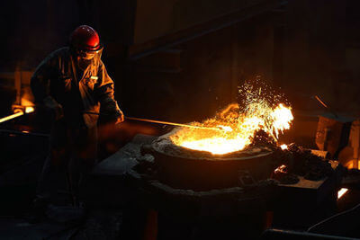
Melting Point
2-D covalent network structures such as graphite have incredibly high melting points (the temperature at which a solid changes state to a liquid).
This is because it requires incredibly high amounts of energy to break covalent bonds within the 2-D covalent network layers of atoms.
Graphite is no exception to this. Even though 2-D network substances have weak intermolecular forces between each layer of atoms, a substantial number of the covalent bonds themselves must be broken to turn the substance from a solid to a liquid.

Slide 24
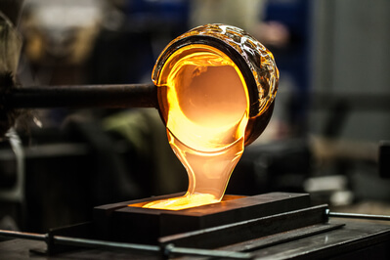
Thermal Conductivity
2-D covalent network substances have good thermal conductivity. This is due to the covalent nature of the bonds within the 2-D sheets that comprise their structure.
The covalent bonds allow the thermal energy (heat) to be passed from atom to atom throughout the sheet. The conduction of thermal energy is efficient within a sheet of atoms, however the conduction of thermal energy between each sheet is significantly lower.
Graphite is used for its thermal conductivity properties today, along with its high melting point, making it an excellent component for blast furnaces and molten steel molds.

Slide 25
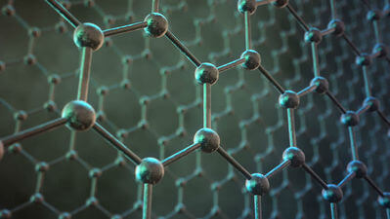
Electrical Conductivity
The nature of the bonding between the carbon atoms that make up the sheets of graphite give it a unique property among 2-D covalent network substances: the ability to conduct an electrical current.
Within each sheet, each carbon atom is sharing three of its valence electrons with three other carbon atoms. This bonding arrangement leaves each carbon atom with a spare unbound valence electron, which is free to move throughout the molecule. This is known as a delocalised electron.
Electrons are charged subatomic particles, and these delocalised electrons are free to move between the carbon atoms of the 2-D sheets. Thus they can carry an electrical current throughout the sheet.

Slide 26
Hardness and Brittleness
Graphite is a soft, slippery solid. This is due to the weak intermolecular forces between the sheets of carbon atoms that make up its structure. These sheets can slide over one another without disrupting the covalent bonding within the sheets themselves. This is why graphite is used in pencil lead. It is so soft that the roughness of the paper it is rubbed on causes sheets of graphite to be removed and deposited on the paper.
A substance is considered brittle if it will break or shatter when stressed, rather than deform/bend in the direction of the applied force.
As with all covalent network substances, graphite and other 2-D substances are very brittle solids. This is because the rigid covalent bonds within the layers will resist the forces applied to them and the substance will shatter before it will bend.

Slide 27
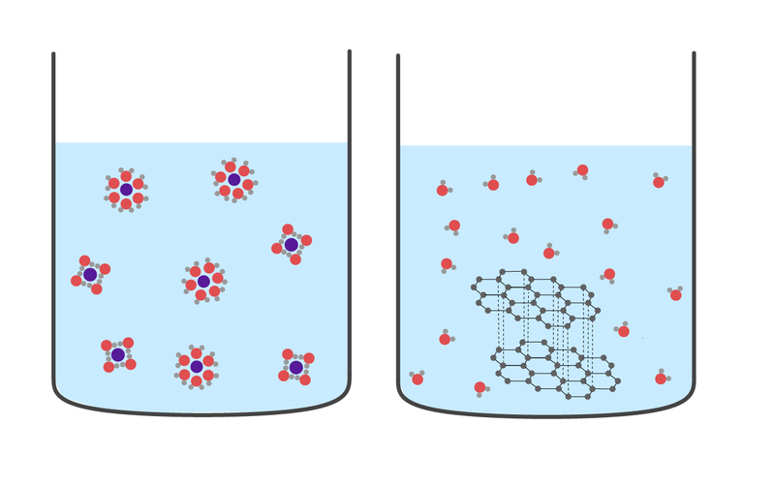
Solubility
A substance is soluble if the attractive forces of the solute (the substance being dissolved) are able to be overcome by the solvent (e.g. water). When something is soluble, the intermolecular forces between the solute and the solvent are greater than the solute to solute forces.
2-D covalent network substances such as graphite are insoluble in both polar and non-polar solvents.
This is because in order for a 2-D covalent network substance to be dissolved, the covalent bonds within each sheet must be broken. The attractive forces between the solvent and the individual atoms are not large enough to break the strong covalent bonds between each atom within the substance.

Slide 28
All of the atoms in 3-D covalent network substances are held in a strong, rigid three-dimensional network.
In this network, every atom is covalently bound to the maximum possible number of other atoms surrounding it.
For this section we will be using silicon dioxide (SiO₂​) and silicon carbide ((SiC) as examples of 3-D covalent network substances.

Slide 29

Melting Point
3-D covalent network substances have characteristically high melting points.
This is due to the nature of the bonding within the substance. The high number of covalent bonds that make up the 3-D structure of the substance require large amounts of energy to break.
This is why silicon dioxide needs to be heated to over 1200∘C in the production of glass.
Silicon carbide has a higher melting point than any known temperature under the conditions present on our planet.

Slide 30
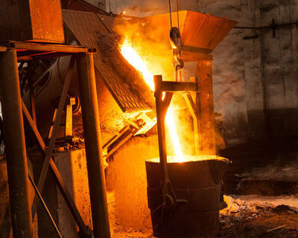
Thermal Conductivity
The high number of covalent bonds allows 3-D covalent network substances to conduct thermal energy (heat) very well.
As every atom is covalently bound to all its neighbouring atoms, it can transfer the thermal energy through these bonds in multiple directions. This allows the thermal energy to quickly pass through the substance.

Slide 31

Electrical Conductivity
As all the valence electrons of every atom in 3-D covalent network substances are being shared within multiple covalent bonds, there are no free electrons within the structure. With no charged particles free to move throughout the substance and carry an electrical current they cannot conduct electricity.
This is why quartz (silicon dioxide) is used in the production of electrical insulators, particularly in silicon based computer chips.

Slide 32

Hardness and Brittleness
3-D covalent network substances are among the hardest naturally occurring substances on the planet. This allows substances such as silicon carbide to be used in industrial grinding tools.
The hardness is due to the nature of the bonding within the 3-D covalent substance. Since every atom present is covalently bound to the maximum number of atoms, it can resist large amounts of force applied to it due to the high number of covalent bonds arranged in multiple directions.
However, the rigid nature of the 3-D lattice of covalent bonds causes these substances to be rather brittle. Rather than bend out of shape when excessive force is applied to the substance, it will shatter.

Slide 33
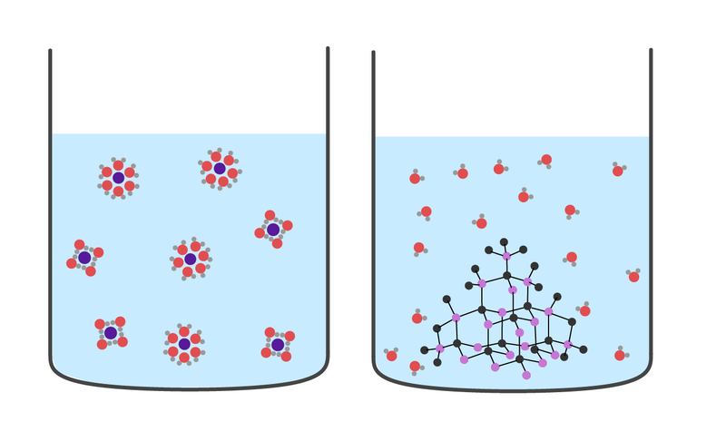
Solubility
3-D covalent network substances such as silicon dioxide and silicon carbide are insoluble in both polar and nonpolar solvents.
Since they exist as large networks of atoms covalently bonded to one another, the attractive forces between individual atoms in the substance are incredibly high. There is no way the attractive forces between the solvent molecules and the individual atoms can overcome the attractive forces within the 3-D covalent network substance.
The left picture shows a soluble substance, in which the solvent molecules have overcome the attractive forces between the individual particles. The right picture shows that 3-D covalent network substances are insoluble. The attractive forces between the solvent and the atoms of the substance are not high enough to overcome the attractive forces of the atom-atom covalent bonds.

Slide 34
Allotropes of Carbon

Slide 35
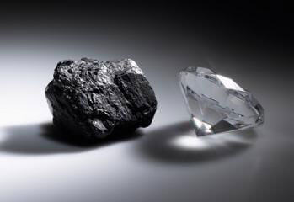
What is an allotrope?
Allotropes are different physical forms of the same chemical element, that exist whilst in the same physical state (solid, liquid, gas).
Allotropes have different physical structures (the arrangement of their atoms) which greatly affects the physical properties of different allotropes.
Some allotropes are naturally occurring and some are synthetically produced by humans, to access structural properties not normally found within nature.

Slide 36
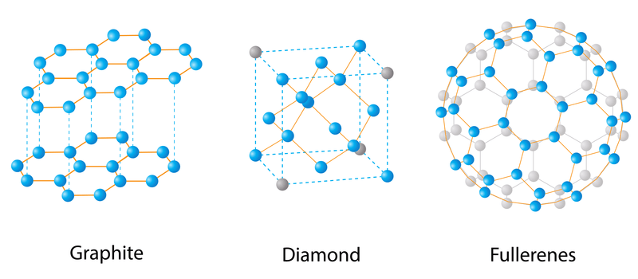
Carbon is one of several elements that exhibits allotropy.
Oxygen and phosphorus also exhibit allotropy but for this lesson we will be focusing on allotropes of carbon.
The three main allotropes of carbon are diamond, graphite and fullerenes. These have multiple applications due to the way their structure and bonding affects the physical properties they exhibit.
Allotropy is the ability of an element to exist in multiple different physical forms.
The three main types of allotropes of carbon. Each one has a unique structure due to the way the carbon atoms are bound to one another.

Slide 37
Diamond
Diamond is an example of a 3D covalent network substance, where every carbon atom is covalently bonded to four other carbon atoms in a tetrahedral lattice.
Diamond is the hardest natural substance on the planet, due to the rigid nature of the bonds within its structure. It is used as a component in high powered cutting tools, such as diamond-tipped saw blades.

Slide 38
Graphite
Graphite is an example of a 2D covalent network substance, where each carbon atom is covalently bound to three other carbon atoms, forming flat hexagonal sheets of carbon atoms.
These sheets are then held together by the weak intermolecular forces that occur between the sheets. These sheets can slide over one another easily without disrupting the covalent bonds within the sheets.

Slide 39
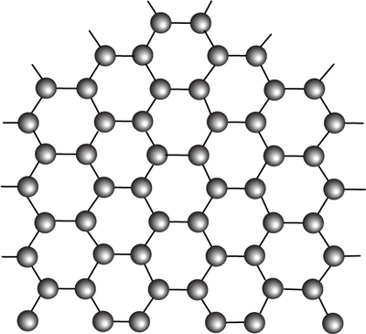
Graphene
Graphene is an allotrope of carbon consisting of one sheet of graphite.
Graphene is the subject of much research, as it retains the excellent thermal and electrical conductivity of graphite, whilst also gaining high tensile strength.
Tensile strength is a measure of a substance's ability to resist being pulled apart.
Due to being only one atom thick, graphene is easily moulded into different shapes. This has applications in advanced materials such as touch screens and solar panels.

Slide 40
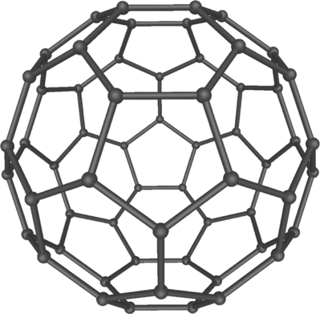
Fullerenes
Fullerenes are the third and most recently discovered allotrope of elemental carbon.
Discovered in 1985 when accidentally synthesised, they have since been found to exist naturally within in the universe.
C_{60​} was the first fullerene discovered (known as buckminsterfullerene), and consists of sixty carbon atoms covalently bound in a hexagonal based sphere arrangement.
Buckminsterfullerene is named after the American architect Buckminster Fuller. These spherical allotropes of carbon are sometimes referred to as "buckyballs".

Slide 41
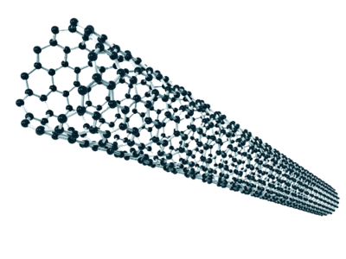
Carbon Nanotubes
Carbon nanotubes are a synthetic type of fullerene that form a long hollow cylinder of covalently bonded carbon atoms.
Due to their tube-like structure, they have incredible tensile strength, whilst retaining amazing electrical conductivity. This has sparked interest in carbon nanotubes for use in advanced structural and electrical components.

Slide 42
Diamond is an excellent example of a 3D covalent network substance, and exhibits all the properties expected from such a substance.
Diamond consists of carbon atoms that are each covalently bound to four other carbon atoms in a tetrahedral arrangement. This forms a stable, rigid lattice of covalently bound carbon atoms extending in three dimensions.

Slide 43
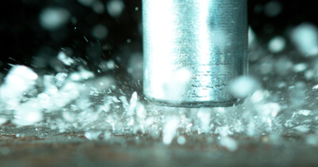
Diamond is one of the hardest substances on the planet, due to the stable, rigid lattice of covalent bonds that make up its structure.
These allow diamond to resist large amounts of applied force from multiple directions.
This stable lattice does not allow the atoms within the structure to be moved out of their place within the lattice, without breaking covalent bonds. This results in diamond being quite brittle, as the substances will shatter under excessive force, because the covalent bonds in the lattice cannot bend out of shape.

Slide 44
The large number of covalent bonds within the structure of diamond give it an incredibly high melting point.
This is because it requires large amounts of energy to break the bonds between each carbon atom.
The covalent lattice present in diamond gives it excellent thermal conductivity. Thermal energy can be easily transmitted from one atom to another through these covalent bonds, allowing the heat to pass quickly throughout the substance.
Conversely, this same covalent lattice prevents diamond from conducting electricity. Since every valence electron is occupied in a covalent bond, there are no free charged particles to carry an electrical current.

Slide 45
Graphite is an example of a 2D covalent network substance and has different physical properties to diamond, due to the bonding and arrangement of its carbon atoms.
Graphite consists of carbon atoms covalently bonded to three other carbon atoms, forming flat sheets of covalently bonded carbon.
These sheets are then held together by the weak intermolecular forces that occur between the sheets.

Slide 46

Graphite is a soft, slippery solid. This is due to the weak intermolecular forces that hold the sheets of carbon atoms together.
These forces are comparatively weak and allow the sheets to slide over one another, without disrupting the covalent bonds within each sheet of carbon atoms. This allows graphite to be used in pencil lead, and also as a dry lubricant (in locks and other mechanical parts).
A lubricant is a substance that reduces friction between two surfaces that are in contact with one another, allowing easier movement.
Graphite is also a brittle solid, as the covalent bonds within each carbon sheet are rigid and the substance will shatter when excessive force is applied, rather than bend.

Slide 47
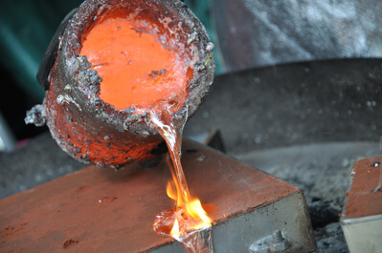
Despite being a soft solid, graphite still has an incredibly high melting point, as the covalent bonds within the sheet must be broken and this requires a large amount of energy.
Graphite also has high thermal conductivity, as the thermal energy can quickly pass between atoms through the covalent bonds that make up each sheet of carbon.
These two properties allow graphite to be used in the structure of blast furnaces and to form the molds for molten steel and glass.

Slide 48

Graphite’s most interesting and unique physical property is its ability to conduct electricity.
Within each sheet, each carbon atom is covalently bound to three other carbon atoms. This leaves one electron per carbon atom free. These are known as delocalised electrons, and are free to move throughout the substance.
Electrical conductivity requires free moving charged particles to carry an electrical current. Graphite is able to conduct electricity, as the delocalised electrons allow the current to move throughout the substance.
With the advent of electric cars the demand for graphite has increased, for use as electrodes within their batteries. Some electric cars can contain up to 40kg of graphite in the form of battery electrodes.

Slide 49
Graphene is an allotrope of carbon consisting of a single sheet of graphite.
This sheet is a single atom thick, which allows it to keep the desirable properties of graphite whilst gaining new properties that give it desirable traits for advanced electronics.
Graphene retains the high melting point, thermal conductivity and electrical conductivity that graphite exhibits.

Slide 50

As a single atom thick sheet, graphene is easily molded and flexible.
This increases its potential for use within electronics and for use in non-metal based electronic wires. This is because graphene has high tensile strength and can be spun into wires (ductility). Graphite does not have these properties because the sheets of carbon can easily slide over one another due to the weak intermolecular forces that hold them in place.
Some research avenues for graphene include use in organic light emitting diodes (allowing for higher definition television and computer screens), biological imaging technology to assist in medical procedures and more efficient solar panels.

Slide 51
Spherical fullerenes are made up of carbon atoms covalently bound into sphere-shaped structures, which exist as discrete molecules.
Like graphene, fullerenes have incredibly high melting points due to the high amounts of energy required to break the covalent bonds within the substance.
They also have high tensile strength, as the high number of covalent bonds can resist force applied to the fullerene in multiple directions.

Slide 52
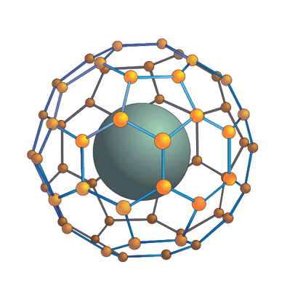
Unlike graphene, spherical fullerenes like buckminsterfullerene act as electrical insulators.
Electrical insulators are substances which prevent the easy flow of electricity through them.
Although there are delocalised electrons within each sphere, fullerenes do not exist as covalent network solids but as discrete molecules. This means that the delocalised electrons cannot move throughout the entire substance and carry an electrical current.
However, fullerenes can act as superconductors if metal atoms are added to their structure. The metal atom exists within the sphere of the fullerene and alters the electrical properties.
A superconductor is a material that can conduct electricity with absolutely zero resistance to the electric current. This allows them to permanently contain an electric current with no power source.

Slide 53
A subset of fullerenes, known as carbon nanotubes, have recently become the subject of extensive research for multiple potential structural and electronic uses.
These synthetic fullerenes are hollow tubes of covalently bonded carbon atoms, with a thickness of a single atom. This allows them to retain the desirable properties of graphene, but with additional benefits.
Carbon nanotubes can still conduct electricity, as each nanotube contains delocalised electrons, which allows an electrical current to travel along the entire length of the carbon nanotube.

Slide 54
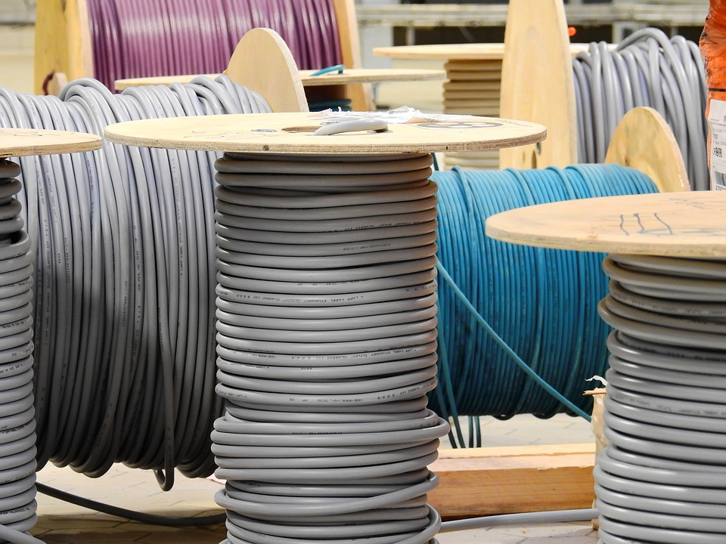
Like graphene, carbon nanotubes are ductile and can be spun into wires and rope-like structures.
However, they have even greater tensile strength compared to the flat sheets of graphene.
This is due to the tube-like structure they possess, which increases the directions in which the covalent bonds between the carbon can resist and disperse the forces applied to it.
The tensile strength and electrical conductivity of carbon nanotubes allow it to be used as both a structural and electrical component at the same time.

Slide 55

Current technology is trending towards miniaturisation, with components getting smaller and smaller.
Current materials have a limitation on how small/thin they can be made whilst retaining structural integrity.
Carbon nanotubes offer a solution to the problem. They are only a single atom thick, allowing incredibly small nanoscale wires with excellent electrical conductivity and high tensile strength to be created.
This has the potential to open the door to nanoscale robotics and high powered computing components.

Slide 56

Space Elevators
Carbon nanotubes possess incredible tensile strength that is orders of magnitude greater than steel. Coupled with its ability to be spun into wires and cables, the uses of these substances in hi-tech construction is being explored around the world.
There is potential for carbon nanotube cables to be the basis for a space elevator from the surface of the planet to the upper atmosphere. This would allow the movement of materials and people into space without the need for rockets.
However, the ability to synthesise carbon nanotubes and create thick enough fibres to support large scale mechanical processes is still some years away.

